Slide 1
ICS2O0 / ICS3C0 (Grade 10/11 Computer Science)
Course Introduction

Slide 2
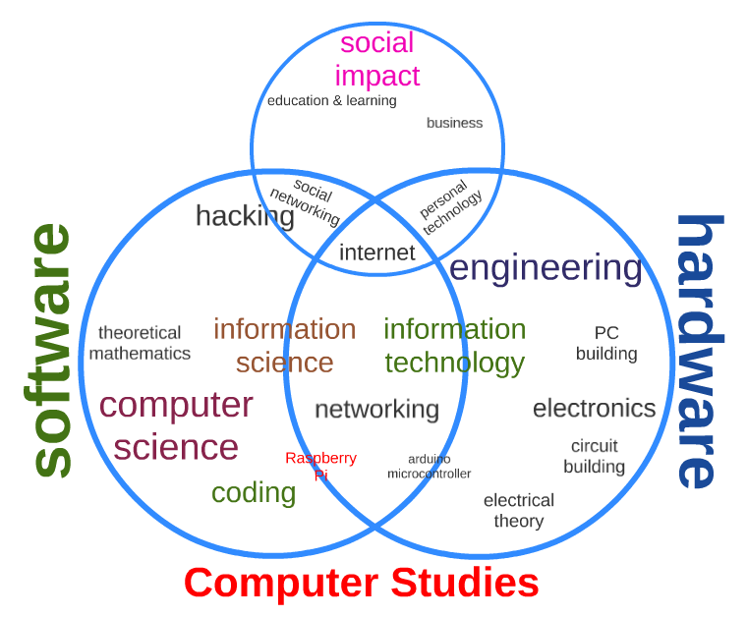
Course Content

Slide 3
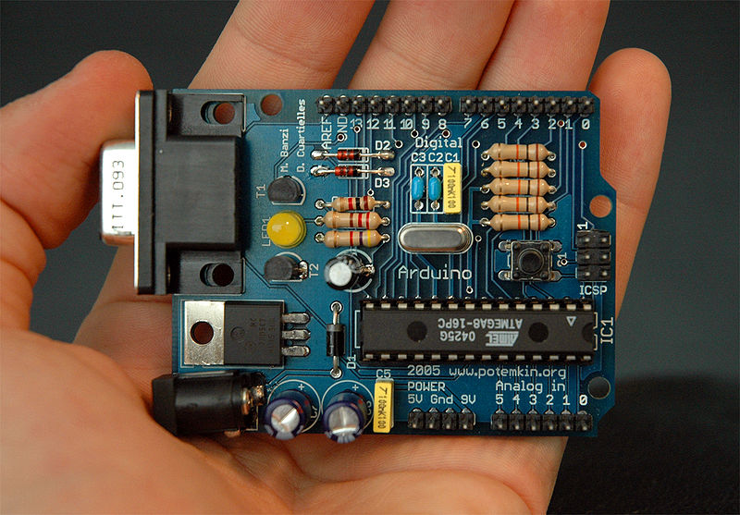
Course Content A – Understanding Computers
Grade 10 Content
describe the functions of different types of hardware components
describe the different types of software products
use the basic functions of an operating system correctly
demonstrate an understanding of home computer networking concepts
explain the importance of software updates and system maintenance
Grade 11 Content
Same as grade 10 content
Less focus on computer networks and system maintenance

Slide 4
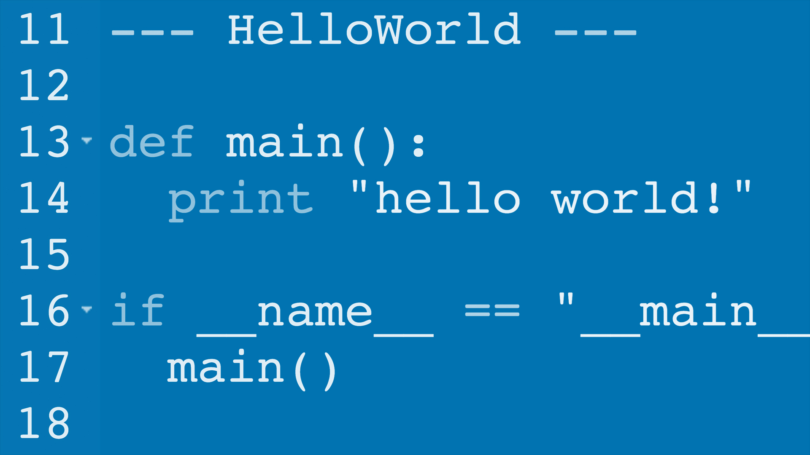


Course Content B – Programming Skills
Grade 10 Content
describe fundamental programming concepts and constructs
plan and write simple programs using fundamental programming concepts;
Grade 11 Content
Same as grade 10 content
Plus greater focus on data types and control structures

Slide 5



Course Content C – Computers & Society
Grade 10 Content
describe key aspects of the impact of computers and related technologies on society;
describe computer use policies that promote environmental stewardship and sustainability;
describe legal and ethical issues related to the use of computing devices;
describe postsecondary education and career prospects related to computer studies.
Grade 11 Content
Same as grade 10 content
Additional Focus On:
procedures for safe computing to safeguard computer users and their data;
impact that emerging technologies have on society;

Slide 6

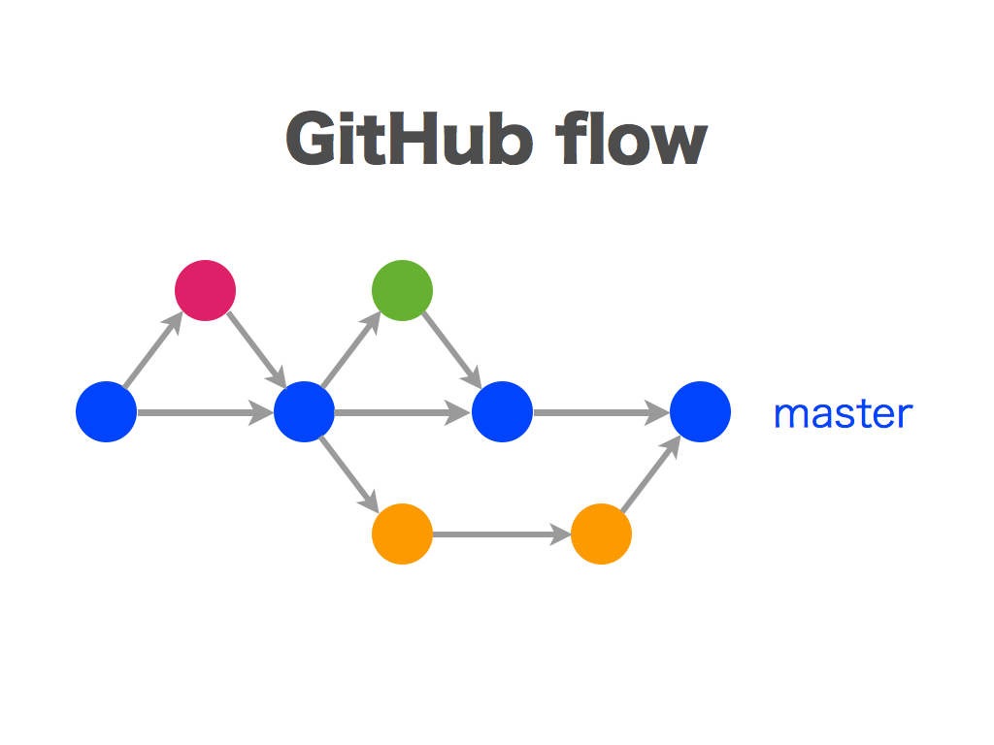
Course Content D – Development Environment
Grade 10 Content
apply basic code maintenance techniques when writing programs
use a software development environment to write and run computer programs
use appropriate file maintenance practices to organize and safeguard data
Grade 11 Content
Same as grade 10 content
Additional Focus On:
use a variety of problem-solving strategies to solve different types of problems
design software solutions to meet a variety of challenges, using a set of standards
design simple algorithms according to specifications
apply a software development life-cycle model to a software development project

Slide 7

Course Evaluation

Slide 8
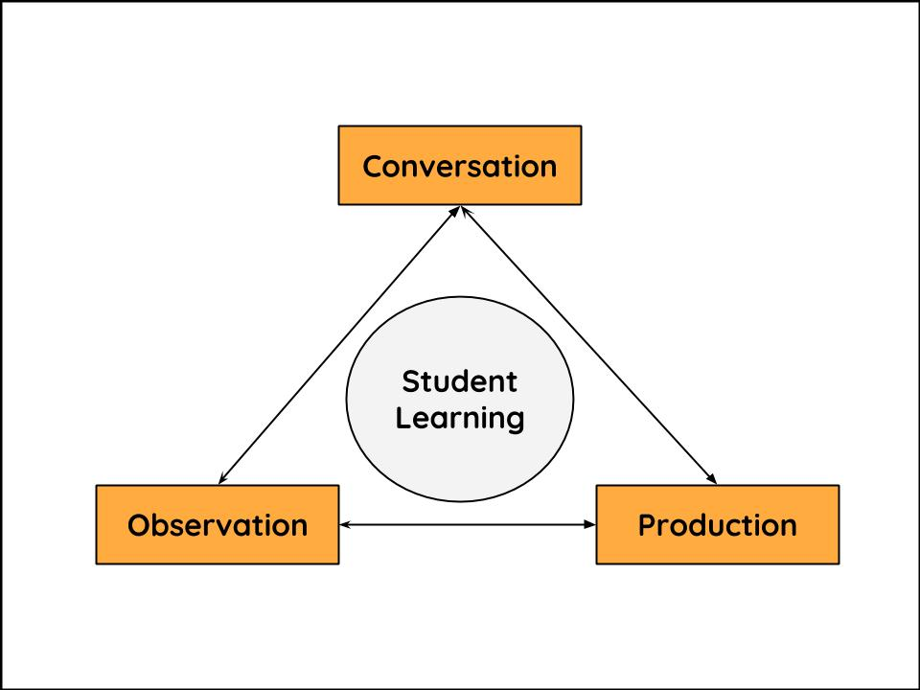
Categories of Knowledge and Skills
4 Categories
Knowledge and Understanding. Subject-specific knowledge and the understanding of its meaning and significance
Thinking. The use of planning, analyzing and creative thinking skills
Communication. Using Computing Terms and proper Programming Style.
Application. Using basic knowledge when answering higher level questions or assignments.
Weighting
The four categories are interconnected and interrelated
Each module, assignment, or test contains all four categories
The 4 categories are weighted equally

Slide 9

Term Work – 70%
Modules & Case Studies
If you do the work you get the mark!
Organized into Level 1, 2, 3, 4 Tasks
Flexible Due Date / At your pace
May resubmit work to complete modules and improve your mark.
Quizzes & Code Challenges
Evaluated on the spot in class
No redos

Slide 10
Mid-Term Test / Final Summative – 30%
Mid-Term Test
Counts for your Mid-Term Mark (30% + 70% Term Work)
3 Parts (3 Days)
Part 1 – Programming Skills - Individual
Part 2 – Short Answers – Individual
Part 3 – Group Challenge – Individual Responses
Open Notes
Final Summative
Counts for your Final Mark (30% + 70% Term Work)
During Last Week Of Classes (No Final Exam)
3 Parts (3 Days)
Part 1 – Programming Skills - Individual
Part 2 – Short Answers – Individual
Part 3 – Group Challenge – Individual Responses
Open Notes

